Slide 2
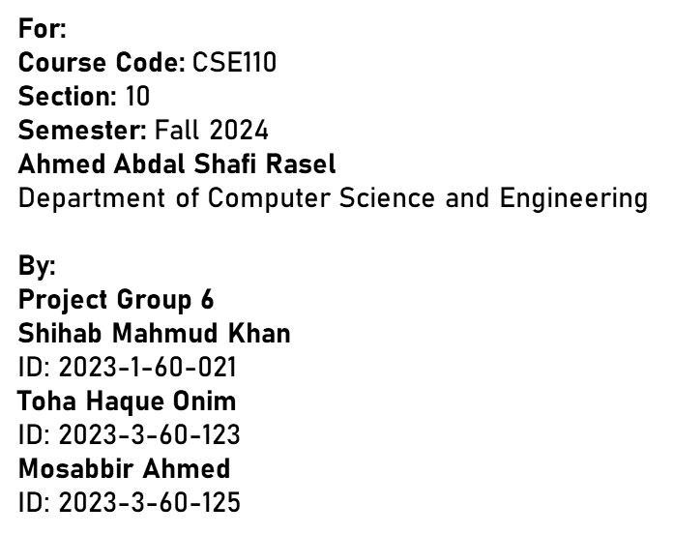


Slide 3
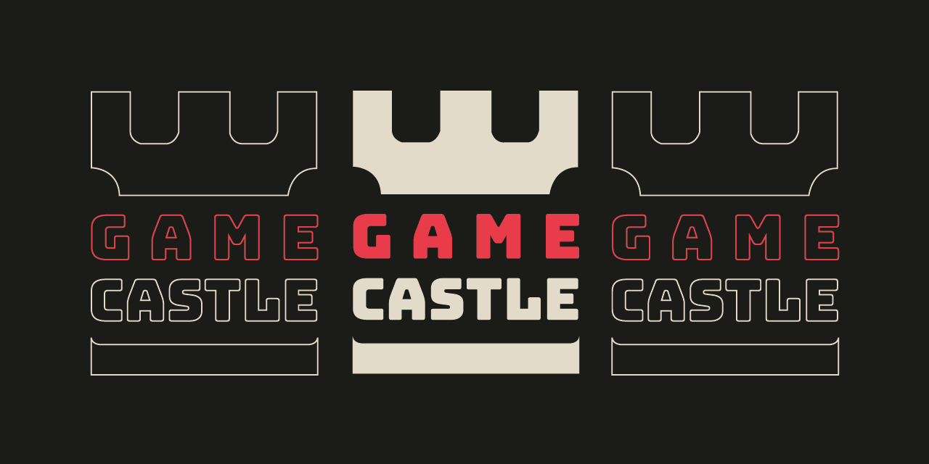

Slide 4

Brief Description of the project
Concepts used in the program
Features of the program
UML Diagram of the program
Demonstration of the program

Slide 5

An online game store management system
Has 100 games stored initially
Users can log in and create account
Admin has a fixed username and password
Customers can buy games whereas admin can add or delete games
Modern and easy to navigate User Interface

Slide 6

Here are the 11 key concepts used in the program:
Inheritance
Method Overriding
Method Overloading
Polymorphism
Abstract Classes
Interfaces
Exception Handling
File Handling
Generics
Encapsulation
MVC Pattern (Model-View-Controller)

Slide 7

Features for customers:
Creating accounts and logging in
Viewing and managing game library
Updating wallet
Purchasing games
Deleting account

Slide 8
Features for admin:
Adding new games to the store
Removing existing games from the store

Slide 9
General features:
Supports role-based user interfaces
Shows alert, failure and success messages after certain actions
Uses one-time passwords for verification
Uses JSON for storing and retrieving data for human readability
Handles exceptional cases to prevent errors

Slide 10
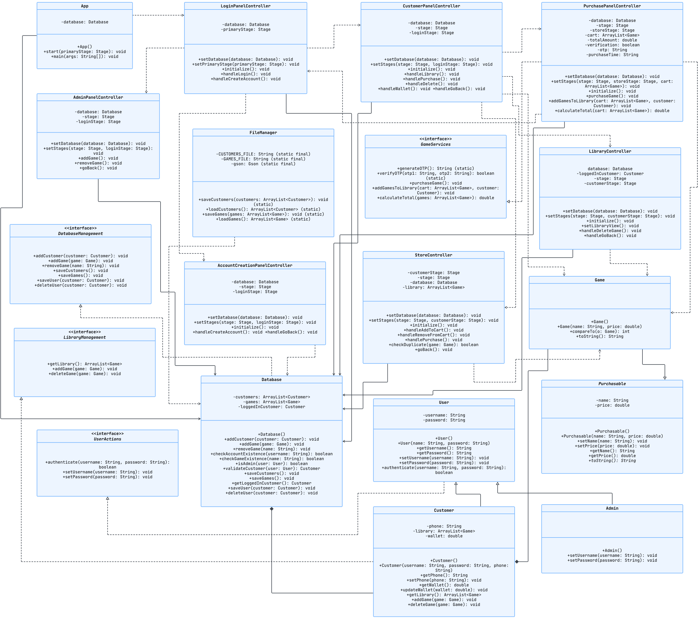


Slide 11
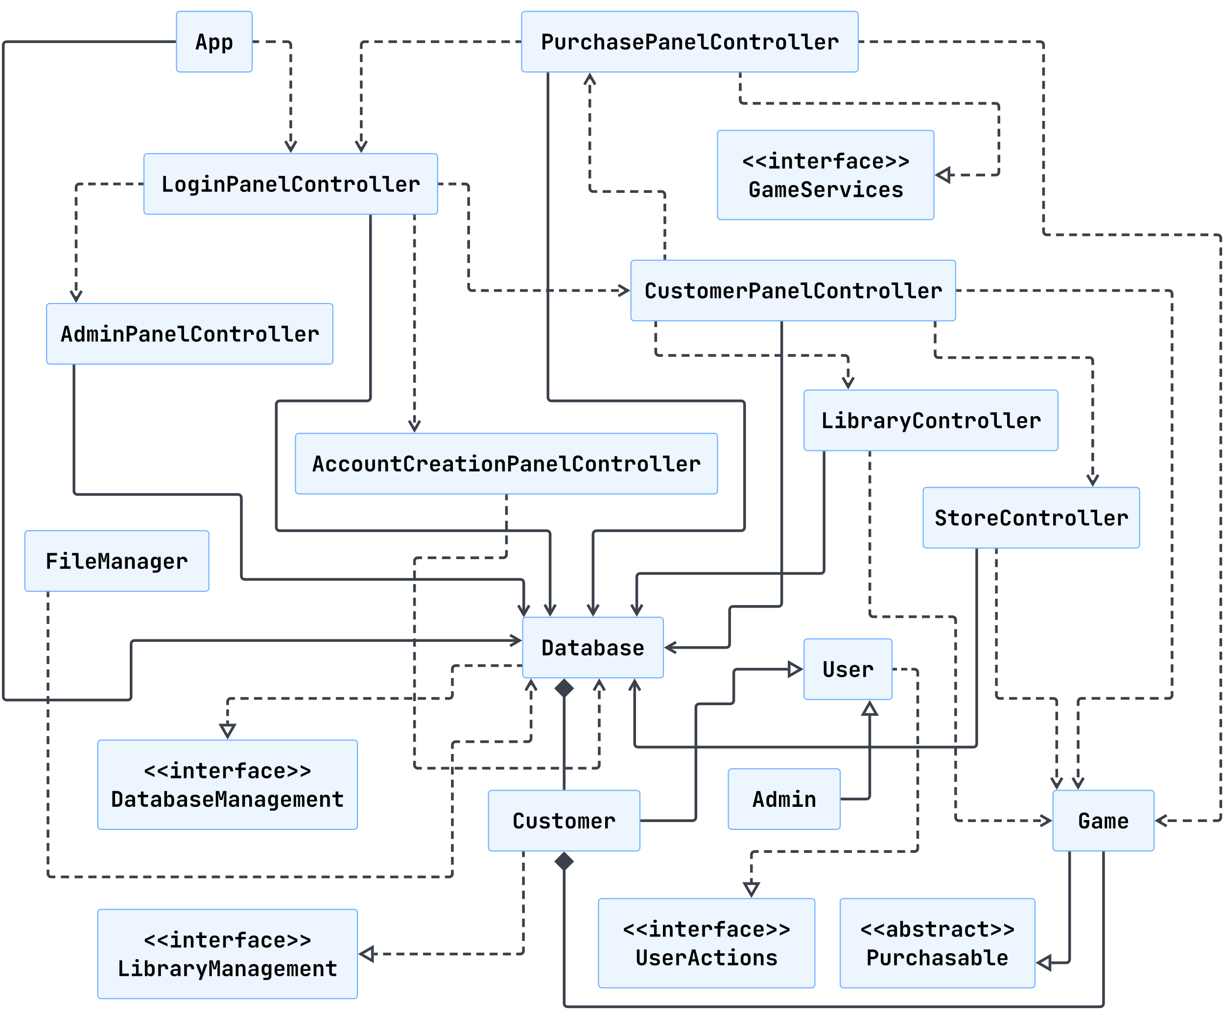

Slide 12




